Slide 1
SystemEver electronic approval
Already Gold
November 27, 2015

Slide 2
Interrelationship between ERP and groupware
2. Settings - Groupware
3. Settings - Electronic Approval Document Settings
1. Confirmation management
ERP
User documentation ( currently configured standard document )
Purchase order , order , shipment request , other shipment request , accounting voucher
Confirmation status management
Payment request
Payment Process
Groupware
Cancel payment
situation
change
Payment
Payment
Final approval
Payment completed

Slide 3
Groupware related Table & SP
division | Table & SP | note
Groupware Settings Related Table | _ TCOMConfirmTable | [ Confirmation Table Management ]
 | _TCOMConfirmDef | [ Confirmation Management ] – Definition of Confirmation Management ( Connection of Confirmation Table )
 | _TCOMConfirmPGM | [ Confirmation Management ] – Registering a screen that uses confirmation
 | _TCOMEnv | Preferences - [ Groupware ]
 | _TCOMEnvGroupWare | Preferences - [ Electronic Approval Document Settings ] DataService , Method, sp to output the payment document number , usage status , and document data Back registration .
 | _TCOMEnvGroupWarePgm | Preferences - [ Electronic Approval Document Settings ] Setting the screen that uses electronic approval and the control that becomes the key value among the items on that screen
Groupware TR Table | _TCOMGroupWare | Electronic approval status value and Table that connects ERP data . that stores SQL statements that change the approval status and stores the electronic approval progress status of ERP data .
 | _TCOMConfirm | About the confirmation of ERP data The status value is saved .
SP | _ SCAGetPageNew | Depending on whether the groupware environment settings are used when linking electronic approval, the ERP screen Automatically generate payment submission and payment status buttons
 | _SCOMGroupWareStart ( For Ever Call internally : _ SWCOMGroupWareStart ) | the payment submission and payment status buttons, a pre-check of the data and an execution statement that changes the status value in _TCOMGroupWare are created .
 | _SCASiteLinkSSOQuery ( Internal call for Ever : _SWCASiteLinkSSOQuery) | Configure the parameters passed when calling the groupware page ( configure in consultation with the company ) -> Yeonglimwon Required parameters + Parameters agreed upon with the groupware company
 | _ SCOMGroupWarePrint ( Internal call for Ever : _ SWCOMGroupWarePrint ) | Document output sp registered in _TCOMEnvGroupWare Common sp calling -> Communication via web services
 | _SCOMGroupWareStatus ( Internal call for Ever : _ SWCOMGroupWareStatus ) | Changes in status values stored in _TCOMGroupWare due to electronic approval submission , completion , cancellation, etc. Execute SQL statements to change electronic approval status . –> Communication via web service .
 | _ SCOMGroupWareNextProc ( Internal call for Ever : _ SWCOMGroupWareNextProc ) | When groupware electronic approval is completed, approval processing related to vouchers is performed.

Slide 4
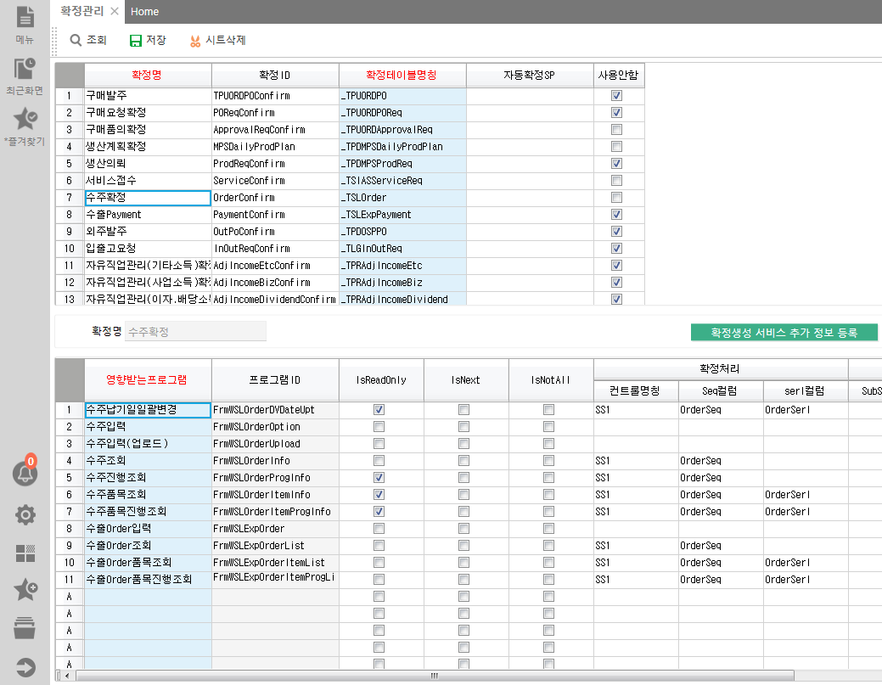
2. ERP settings for groupware use 2 - 1) [ Confirmation Management ] - Screen for defining confirmation-related terms and registering programs that use confirmation.
Table : _TCOMConfirmDef
In order to manage confirmation through electronic approval, you must first use the confirmation function .
to find the name you want to use and uncheck [ Do not use ] .
Table : _TCOMConfirmPGM
Since we want to confirm through electronic approval, we need to disable the confirmation column on the ERP screen so that confirmation cannot be done .
[ IsReadOnly ]​ If checked, the corresponding confirmation column will be shown as disabled .

Slide 5
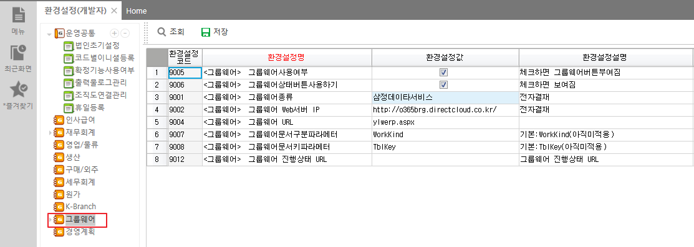
2. Groupware ERP setup for use 2 - 2) Preferences - [ Groupware ] - Select and configure the groupware to connect.
Table : _TCOMEnv
Item Description :
<Groupware> Whether to use groupware : If you check this item when using groupware, the 'Submit Approval' button will appear on the electronic approval screen . You can connect to the groupware by clicking the button .
<Groupware> Using the Groupware Status Button : When using groupware , if you check this item, the ' Approval Status ' button will appear on the electronic approval screen . Click the button to connect to the groupware and check the approval progress .
< Groupware > Groupware type : You can select a groupware company ( Dongbu , Samjeong Data Service , etc.)
< Groupware > Groupware Web Server IP:
< Groupware > Groupware URL:
4 (9002) Groupware Web server IP + 5 ( 9004) Groupware URL: URL that can call the groupware page when submitting payment
Groupware​​ Groupware document classification parameters : Groupware document classification parameter name ( value that does not need to be modified )
Groupware​​ Groupware document key parameters : Internal key of ERP screen using groupware As a parameter Name when passing . ( Value that does not need to be modified .)
Groupware​​ Groupware progress status URL: In some cases, the groupware page used when submitting electronic approval and the groupware page used to check the electronic approval progress status are different, so use this in that case .
4 (9002) Groupware Web server IP + 8 ( 9012) Groupware progress status URL: URL that calls the groupware page when checking the payment status

Slide 6
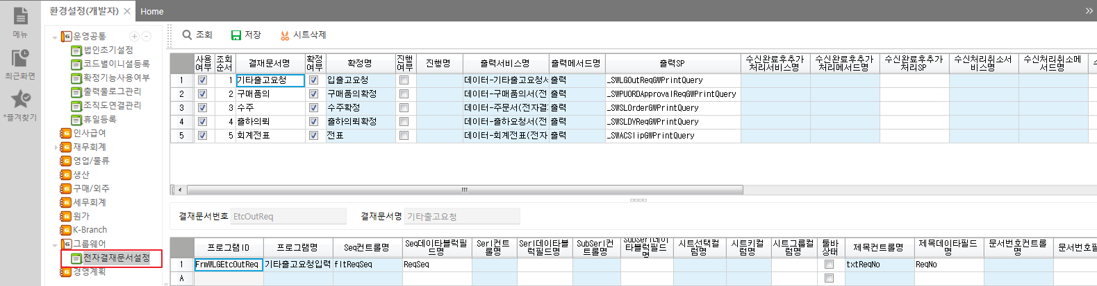
2. ERP settings for groupware use 2-3) Preferences - [ Electronic Approval Document Settings ] - Register DataService , SP , etc. for confirmation and document data inquiry for each electronic approval document, and register the screen used for each electronic approval .
Table : _TCOMEnvGroupWare
Table : _TCOMEnvGroupWarePgm​
First sheet : Currently consists of 5 standard documents .
Usage : In Preferences - [ Groupware ] , the use of groupware is checked and the use of each approval document must be checked for the approval submission button to be displayed on the electronic approval screen registered below .
Approval Document Number : A key value that identifies each electronic approval document . The table where the electronic approval status value is stored is TCOMGroupWare. At WorkKind Saved as . When calling the groupware page WorkKind Passed as a parameter called . ( Required key value , value that must not be modified .)
Confirmation : This item selects whether to use the confirmation function for ERP data when processing electronic approval . ( The use of ERP electronic approval related to the work flow is generally intended to confirm ERP data as soon as electronic approval is completed . Modification and progression to the next step are controlled before the data is confirmed .)
Confirmed name : Select the confirmed name registered in [ Confirmation Management ] .
Progress : If the column is checked, ERP data that has progressed to the next step of the process cannot be canceled through electronic approval . ( Currently, Dongbu and Samjeong cannot cancel electronic payments after they have been completed . Therefore, checking the ' Progress ' box is meaningless .)
Register DataService , Method, and SP for printing in groupware documents .
- Things to keep in mind when creating document output SP : When writing an output sp , all data to be output must be processed in sp to process decimal points , date format, etc. as desired and output in string format .
The output created in sp is delivered to the groupware company as is so that it can be modified later. To allow only sp to be modified . ( number , amount)
The part that handles currency and decimal points according to the ERP environment settings is _ fnGWAmtCommma You can use functions .)
Second sheet :
Register a screen to use the payment document registered in the first sheet
Seq control , Seq data block field name : Select the item that will be the key value on the screen , DataFieldName of the selected key value item Enter .
If there are multiple key values used when confirming the screen, up to 3 can be entered . ( Serl , SubSerl) Just enter the required key value .)
Title control name & title data field name : TblTitle Pass data to be combined into a title as a parameter . ( In the electronic approval document, it will be created in the form of ' Default Title - TblTitle ' .)
Document number control name : ErpNo Pass data to be used as document number as parameter ( does not apply to Dongbu and Samjeong )

Slide 7
3. Description of URL & parameter values required when connecting to groupware
Calling groupware web pages
- [' Groupware Web Server IP' + ' Groupware URL'] saved in the settings and the parameter value agreed upon with the groupware company Calling the groupware web page .
Parameter values agreed upon with the groupware company
- Configure the mutually agreed parameter values in _SCASiteLinkSSOQuery and pass them to the groupware web page .
URL connected when clicking the Payment Submission or Payment Status button is different
- You can specify it differently in the settings . ( Explained in 2-2 )
parameter values passed when clicking the Payment Submission or Payment Status button are different
- _ Can be configured differently in SCASiteLinkSSOQuery .
- @GWValue4 = in that sp If it is 1 , it means that the ' Payment Status ' button was clicked .

Slide 8
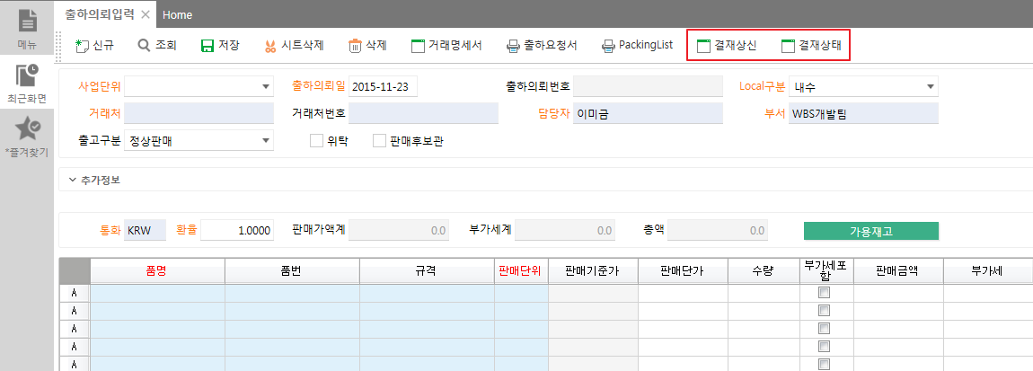
4. Create a button according to groupware-related settings
Click the ' Approve Submission ' button to connect the groupware and proceed with electronic approval.
' Approval Status ' button and connect to the groupware to check the electronic approval progress of the relevant case.

Slide 9
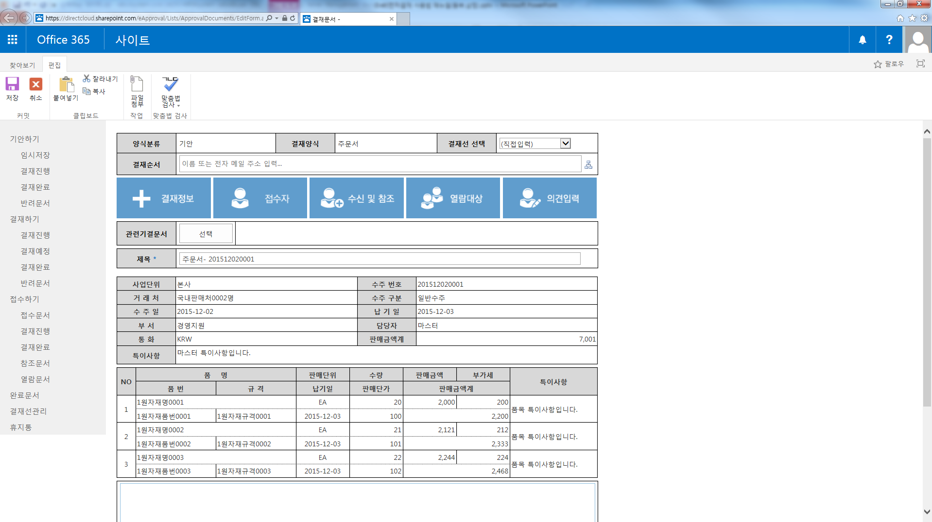
Click the ' Approve Submission ' button to connect to the groupware (Office365) page.

Slide 10
5. Table changes according to electronic approval submission
1. [ Shipping Request Input ] Enter and save data
- If you save on that screen, confirmation management will be done in the groupware settings, so confirmation-related data will be created in _ TCOMConfirm.
2. Click the ' Approval Submission ' button on the ERP screen .
Using _ SCOMGroupWareStart _Generate a status change SQL statement to be called according to electronic approval-related actions ( electronic approval submission , approval completion , approval cancellation, etc. ) in TCOMGroupWare .
- WorkKind: Approval document number , TblKey : Key value of the screen configured in [ Electronic Approval Document Settings ] in the Preferences . ( In the example, the internal code for the shipment request is 92)
3. Go to the groupware page : Depending on the electronic approval-related action, the groupware company calls the status change web service provided by Yeonglimwon to _ SCOMGroupWareStatus Execute . ( The details below are in the electronic approval area )
3-1. Payment submission
- _ Run ProgSQL of TCOMGroupWare . IsProg value changes to 1 .
- CfmCode value in _TCOMConfirm changed to 5
3-2. Payment completed ( final approver approval )
- _ Execute ProgSQL of TCOMGroupWare . IsProg value changes to 1 and IsEnd value changes to 1 .
- CfmCode value in _TCOMConfirm changed to 1
3-3. Cancellation of payment ( rejection , document deletion )
- _ Delete the corresponding data of TCOMGroupWare .
- CfmCode value in _TCOMConfirm changed to 0

Slide 11
6. Settings when using Samjeong Data Service (Office 365 ) groupware .
[ Required Actions ]
1. Items to be provided to the Samjeong Database
Corporate Number (CompanySeq)
Fixed SecuKey ( _ TDEVCust: Guid stored in the customer business DB )
WCF Service EndPoint address ( HttpExecute Service URL )
- Example : WBS development server : http://wbs.ksystem.co.kr:8088/AngKor.Ylw.Common.HttpExecute/httpexecute.svc
ABCInit : http://abcinit.cloudapp.net/HttpExecute.svc
2. Yeonglimwon internal settings : Environment settings - [ Groupware ] settings
< Groupware > Groupware Type (9001): Samjeong Data Service (9001502)
< Groupware > Groupware Web Server IP (9002): http://o365brg.directcloud.co.kr /
< Groupware > Groupware URL (9004): ylwerp.aspx
< Groupware > Groupware connection authentication key (9103): Authentication key provided by Samjeong ( different for each customer . ( Required value ))
This item is special and should not be opened from the Preferences screen .
( You must insert directly into the table in the DB .)
[ significant ]
( Samjeong ) Groupware connection authentication key ( setting : 9103) creation process description
1) New customer contract .
2) At Yeonglimwon Fixed SecuKey(_TDEVCust: Guid), CompanySeq, based on customer information contracted with Samjeong Data Service
WCF Service EndPoint Provide your address .
3) When connecting groupware using fixed SecuKey and CompanySeq in Samjeong Data Service
Generate the authentication key (DCGWAuthKey) to be used and send it to Yeonglimwon .
4) Save the given authentication key (DCGWAuthKey) in the environment settings (9103) . ( In the DB )
( Samjeong ) The parameter passed to the groupware connector is configured separately in _SWCASiteLinkSSOQuery .

Slide 12
Samjeong Data Service (Office 365) groupware usage process
contract​
New customers
contract​
Yeonglimwon Soft Lab
Samjeong Data Service
Corporate Number (CompanySeq)
WCF service EndPoint address ( HttpExecute Service URL)
Fixed SecuKey ( Guid )
Internal settings
Groupware connection authentication key ( DCGWAuthKey )
Internal settings
Register by email account
Register by email account
User registration
manager​
User registration

Slide 13
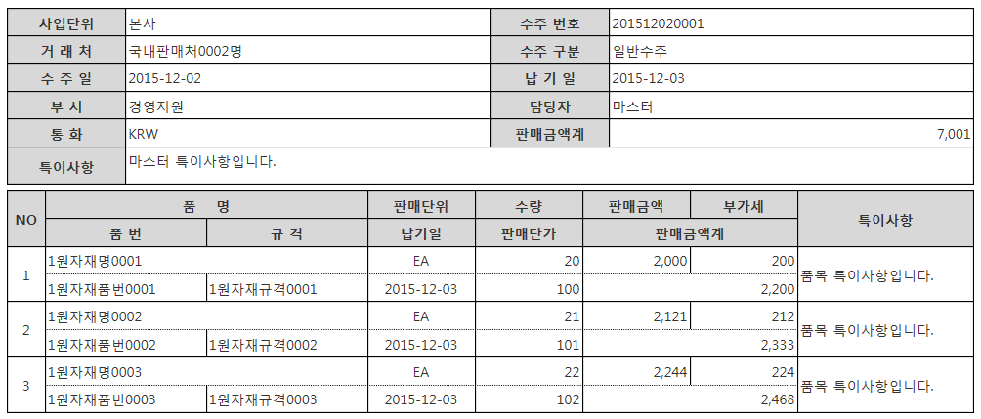
6-1. Samjeong Data Service (Office 365) - Approval Document Forms ( 5 ) [ Order Form ] – Item Composition and Form

Slide 14
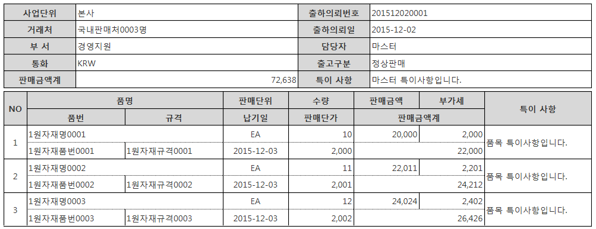
6-2. Samjeong Data Service (Office 365) - Payment Document Forms (5 ) [ Shipping Request Form ] - Item Composition and Form

Slide 15
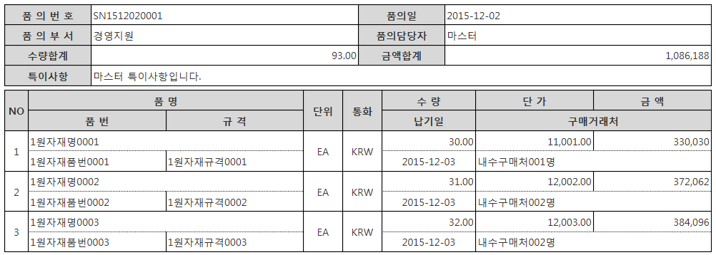
6-3. Samjeong Data Service (Office 365) - Payment Document Forms (5 ) [ Purchase Inquiry Form ] - Item Composition and Form

Slide 16
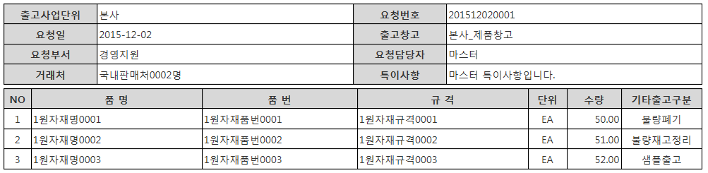
6-4. Samjeong Data Service (Office 365) - Payment Document Forms (5 items ) [ Other Delivery Request Form ] - Item Composition and Form

Slide 17
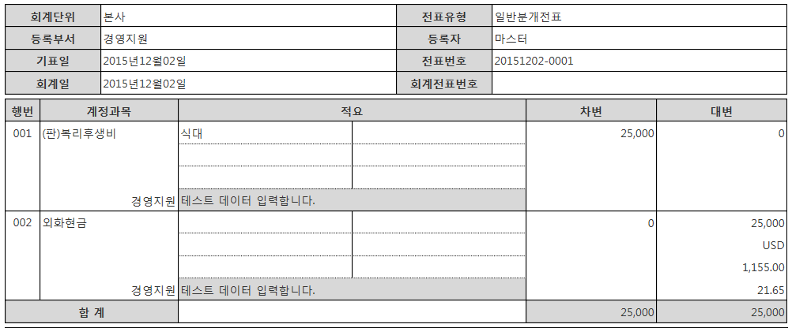
6-5. Samjeong Data Service (Office 365) - Approval Document Forms (5 ) [ Accounting Voucher ] - Item Composition and Form

Slide 18
7. Settings when using Eastern (Google Apps -based ) groupware .
[ Required Actions ]
1. Items to be provided to the East
SecuKey ( _TDEVCust: Guid stored in the customer's business DB )
TargetURL ( Yeonglimwon ERP HttpExecute service URL)
- Example : WBS development server : http://wbs.ksystem.co.kr:8088/AngKor.Ylw.Common.HttpExecute/httpexecute.svc
ABCInit : http://abcinit.cloudapp.net/HttpExecute.svc
2. Yeonglimwon internal settings : Environment settings - [ Groupware ] settings
< Groupware > Groupware Type (9001): Eastern (9001501)
< Groupware > Groupware Web Server IP (9002): https://sun-sign-dev-two.appspot.com/jsp/extlink/saas/
< Groupware > Groupware URL (9004): erpLinkStart.jsp
[ significant ]
( East ) The parameter passed when connecting to groupware is used as the default value in _SWCASiteLinkSSOQuery .

Slide 19
Process when using Eastern (Google Apps - based ) groupware
contract​
New customers
contract​
Yeonglimwon Soft Lab
East
TargetURL ( HttpExecute Service URL)
SecuKey ( Guid )
Internal settings
Internal settings
Register by email account
Register by email account
User registration
manager​
User registration

Slide 20
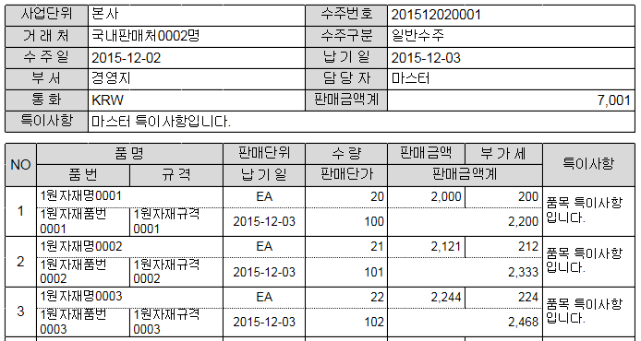
7-1. East (Google Apps -based ) - Payment Document Forms (5 ) [ Order Form ] - Item Composition and Form

Slide 21
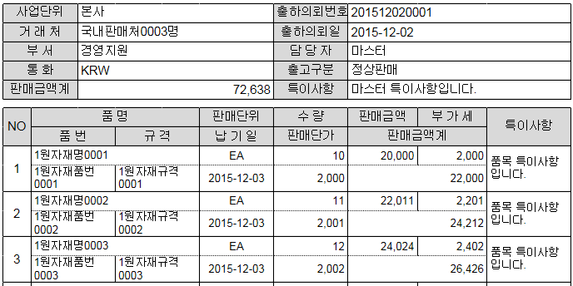
7-2. East (Google Apps -based ) - Payment Document Forms (5 ) [ Shipping Request Form ] - Item Composition and Form

Slide 22
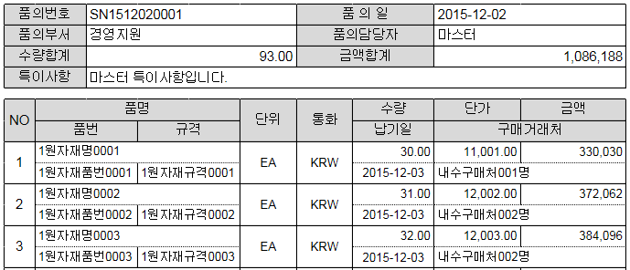
7-3. East (Google Apps -based ) - Payment Document Forms (5 ) [ Purchase Inquiry Form ] - Item Composition and Form

Slide 23
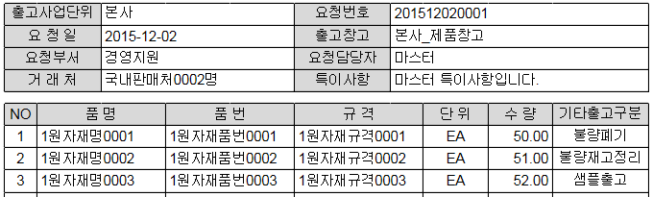
7-4. East (Google Apps -based ) - Payment Document Form (5 items ) [ Other Delivery Request Form ] - Item Composition and Form

Slide 24
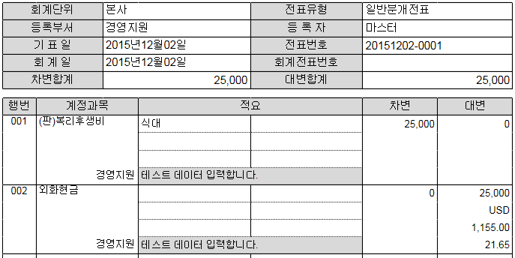
7-5. East (Google Apps -based ) - Approval Document Forms (5 ) [ Accounting Voucher ] - Item Composition and Form

Slide 25
thank you .

